Slide 1

O CIO nos tempos modernos.
(Cuidado: além de sistemas legados, podem existir diretores legados…)
Edson Fregni
Forrester Research, Inc
Escola Politécnica da USP
Legado e Evolução II
RELATÓRIO BANCÁRIO
28 de Setembro de 2006

Slide 2
Conteúdo
Analisando o cenário dos últimos 60 anos
  A História do Diretor de Tecnologia
O Mundo do Diretor de Tecnologia moderno e seus desafios
  Governança
  Terceirização
  Inovação
Notes:
Origins
The role of Information Systems (IS) has developed during the years. The original conception was of automation of existing manual and pre-computer mechanical processes. This was quickly succeeded by the rationalisation and integration of systems. In both of these forms, IS was regarded primarily as an operational support tool, and secondarily as a service to management.
During the 1980s, an additional potential was discovered. It was found that, in some cases, information technology (IT) had been critical to the implementation of an organisation's strategy. The dominant sense in which the term is used is that a strategic information system (SIS) is an information system which supports an organisation in fulfilling its business goals.
An alternative interpretation of the term is that it is not necessary a particular IS, but rather the combination of those parts of an organisation's cluster of information systems which provide information into its strategic planning processes (Higgins & Vincze 1993. p.93). The functions involved include the gathering, maintenance and analysis of data concerning internal resources, and intelligence about competitors, suppliers, customers, government and other relevant organisations.
A variety of interpretations of strategy exist, most of which have a great deal to do with competition between corporations. Chamberlin's theory of monopolistic competition sees corporations as being heterogeneous, and competing on the basis of asset differences, such as technical knowledge, reputation, ability for teamwork, organisational culture and skills, and other 'invisible assets' (Chamberlin 1933, Itami 1987). Competition therefore means cultivating unique strengths and capabilities, and defending them against imitation by other firms. Another alternative sees competition as a process linked to innovation in product, market, or technology (Schumpeter 1950).
[fonte: http://www.anu.edu.au/people/Roger.Clarke/SOS/StratISTh]

Slide 3
Últimos 60 anos
Analisando o Cenário
“O sapo pula não é por boniteza, mas por percisão.”
[ditado mineiro,
citado por Guimarães Rosa]

Slide 4
Um pouco de história
As eras da Informática
Cérebro Eletrônico – década de 50
    Começou na década de 40 e avançou pela década de 50
Processamento de dados – década de 60
    Começou na década de 50 e avançou até meados da década de 70
Sistemas de Informação – década de 80
    Começou na década de 70 e avançou até finais da década de 80
Tecnologia da Informação – década de 90
    Década de 90 até pós ano 2000

Slide 5
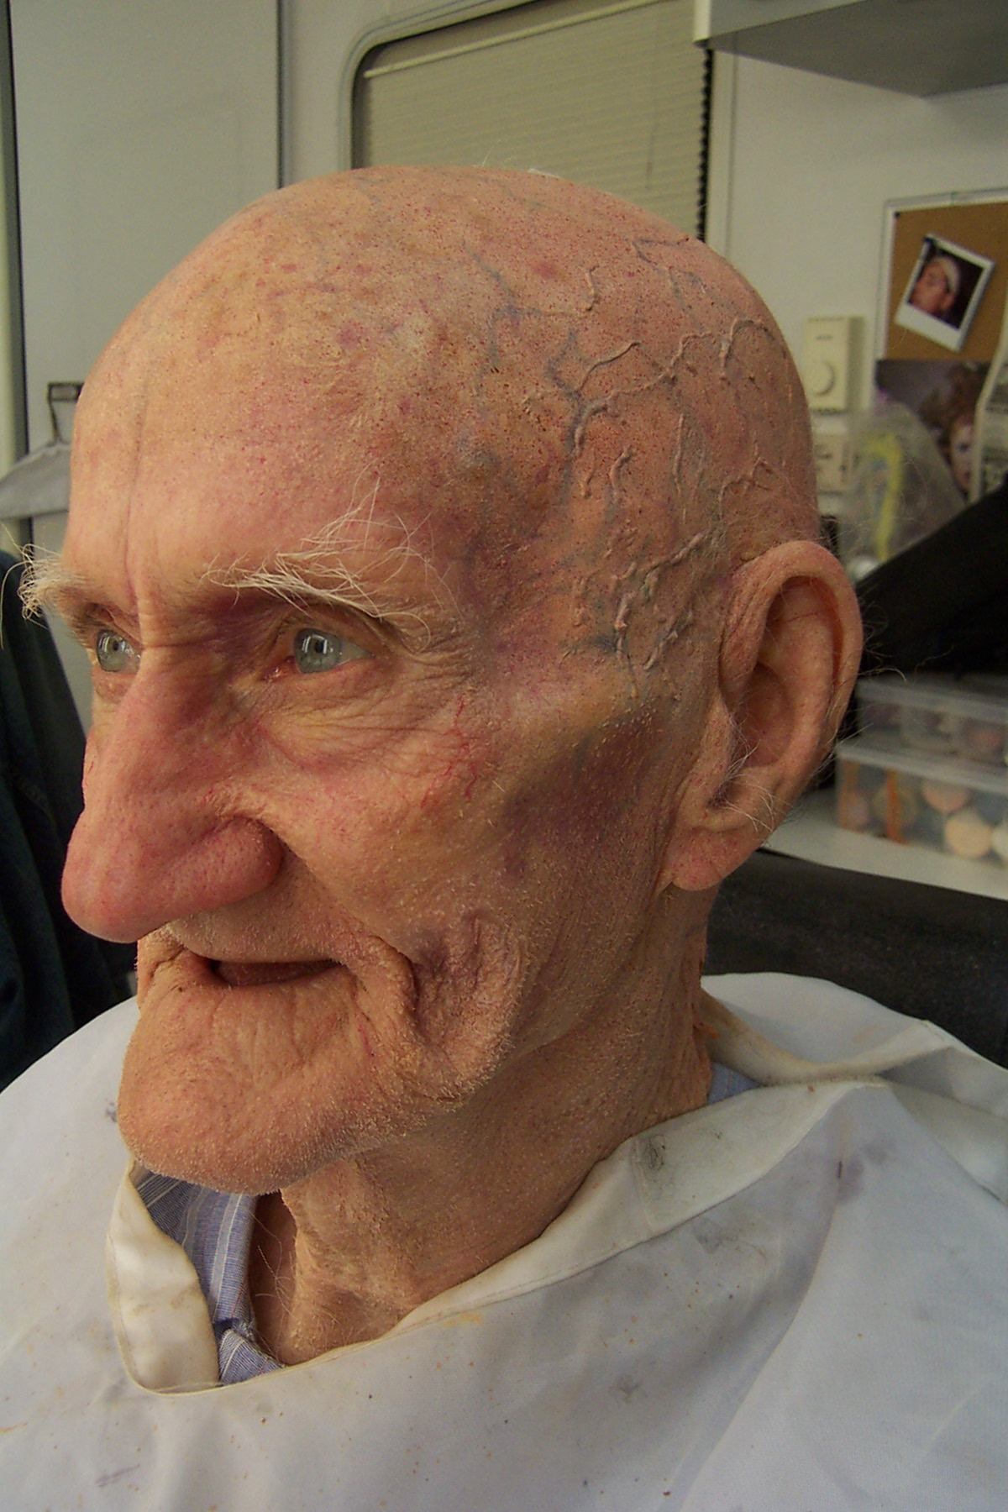
Tempos Remotos
Cérebro Eletrônico
Tempos heróicos
  A invenção do computador… teve data?
  O hardware e o software… a dicotomia da guerra fria…
As funções científicas
O início da maturidade com a IBM
Década de 50
Cientista do Computador
ENIAC

Slide 6
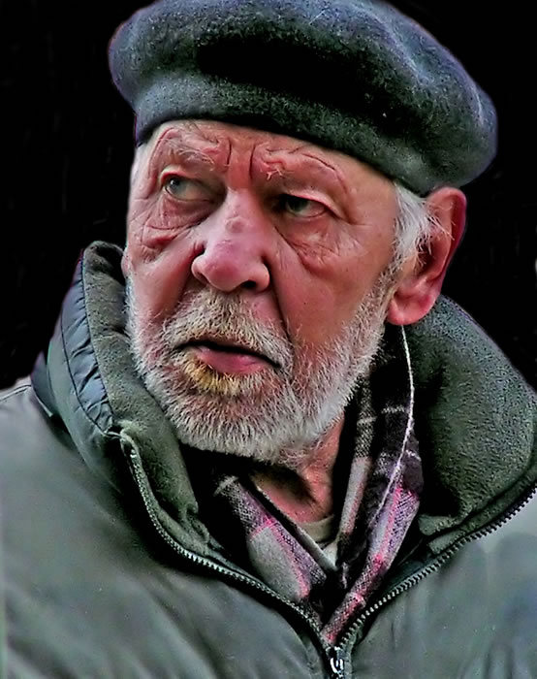
Década de 60
Processamento de Dados
Mainframes, IBM + BUNCH
Folha de pagamento, faturamento
Computador apoiando os negócios
O inicio da revolução
  A microeletrônica
  O PDP-8…
  A rede ARPA é iniciada
Década de 60
Gerente do Centro de Processamento de Dados
IBM1401

Slide 7
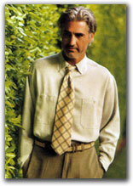
Década de 80
Sistemas de Informação (Informática)
Time sharing, o Multics
Capacidades começam a ficar exorbitantes… mas insuficientes…
A promessa da Lei de Moore
A rede é o computador…
A Rede Arpa cresce sorrateiramente…
Década de 80
Diretor do MIS
IBM PC XT

Slide 8
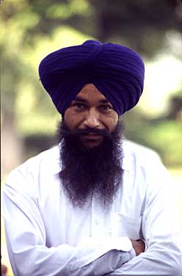
Década de 90
IT – Information Technology
Dowsizing… o imaginado fim dos mainframes…
O computador tornando-se commodity…
A Internet começa a ofuscar tudo à sua volta… inclusive o bom senso da maioria.
… as incertezas… como se perceber no meio de uma revolução tecnológica.
Década de 90
Chief Information Officer
Rede de Computadores

Slide 9

Hoje
Tecnologia de Negócio ?
Imagine um teste:
  Desligue todos os equipamentos da empresa
  Consegue ela continuar operando?
A tecnologia é mais que da Informação
  É Tecnologia de Negócios…
  Não é mais CIO… é CBT (Chief Business Techologist).
  Não seria melhor DTN?
  O Bradesco é uma das empresas que já descobriu isso.
Década de 00
Chief Business Technologist

Slide 10
Os Profissionais da Tecnologia de Negócio
Tecnologia: pervasiva, móvel, volátil
Profissionais de TI: enfrentando um mundo de muitas e rápidas mudanças, demandas crescentes, papéis em mudança acelerada
IT’s Role Has Changed
The New IT Career Paths

Slide 11
O ENIAC foi construído em 1946:
Vivemos 60 anos de profunda tranformação
O legado das seis décadas
  Gerações e gerações de sistemas foram sendo implantados nos computadores das empresas
  Camadas mais novas sobre camadas velhas
  Reparos, ampliações…
Os profissionais também foram sendo ultrapassados e ficando obsoletos ao longo da jornada
  Linguagens, arquiteturas, conceitos
  Gerações de profissionais mais novos, sobre gerações de profissionais mais velhos

Slide 12

Pensamentos e abordagens profissionais muito diferentes
Década de 50
Década de 60
Década de 80
Década de 90
Década de 00
Cientista do Computador
Gerente do Centro de Processamento de Dados
Diretor do MIS
Chief Information Officer
Chief Business Technologist
Você se identifica aqui?

Slide 13
O Mundo de Hoje
Outono
Outrora
Era outro
[Hai Kai de Alonso Alvares]

Slide 14
Os sistemas de computação
Como são hoje?
Interligados
Complexos
Poderosos
Pode adjetivar com muito, extraordinariamente, excessivamente…
Novas Fronteiras

Slide 15
Três desafios para o Chief Business Technologist…
ARRUMAR A CASA
Governança
Terceirização
Legado
Inovação
Produtividade - Alinhamento - Flexibilidade -ObsolescênciaAdiada - Robustez - Visibilidade
Competitividade - Controles

Slide 16
Desafio: Governança
Aprendendo a abrir mão do poder
Não se falava em governança quando a área de informática era soberana e chefes mandavam
Constatando que só se alinha quem compartilha responsabilidades, projetos e sonhos
Descobrindo a importância dos comitês, apesar da lentidão
E mais: precisamos ser gestores profissionais

Slide 17
Desafio: Terceirização
Afinal existe quem faz melhor que você…
Descobrindo que muitos serviços de TI são commodities e esperando que outros resolvam os problemas que nos assustam
Aprendendo a negociar e a controlar grandes contratos com grandes fornecedores
Lidando com medos da equipe
Será que é mesmo mais barato? Será?

Slide 18
Desafio: Inovação
Será que é possível?
Tendo que domar a fera do cotidiano com
  Processos
  Orçamento especial
  Apoio superior
Acreditando que as pessoas querem e podem se renovar
Lembre-se: seguir também é digno. Principalmente quando se segue bem próximo.

Slide 19
Encerrando
Parece tudo muito desafiador
Mas, como sempre, o monstro fica sempre menor ao meio dia.
Chuva cai lá fora.
No batuque das goteiras,
Eu durmo tranqüilo.
[Hai Kai de Natacha Lemes Batistão]

Slide 20
Obrigado
Hai Kai’s de: http://www.seabra.com/cgi-seabra/haikai/randtxt.pl/haikai.html
Dois relatórios da Forrester Research foram utilizados nesta apresentação:
  “Is There A Career Future In Enterprise IT?”, por Laurie M. Orlov and Samuel Bright
  “My View: IT To BT”, por George F. Colony
  Consulte: www.forrester.com
Cópia desta apresentação, solicitar: efregni@gmail.com

Slide 21
Slides Complementares

Slide 22

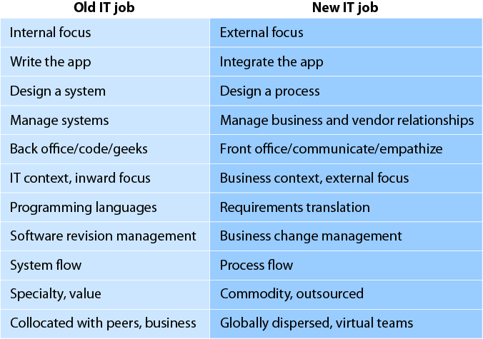
IT’s Role Has Changed
August 2006, Trends “Is There A Career Future In Enterprise IT?”

Slide 23
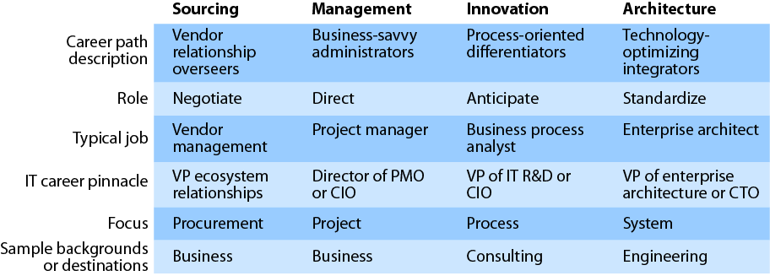
The New IT Career Paths
August 2006, Trends “Is There A Career Future In Enterprise IT?”

Slide 24
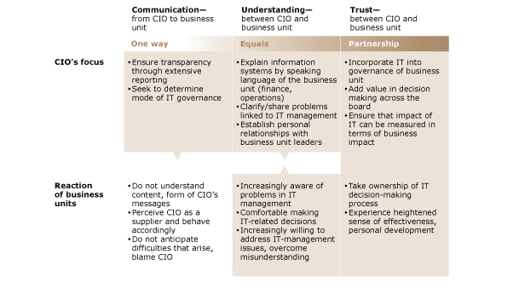
McKinsey Quarterly - Setembro 2006
O Valor dos Líderes de IT
Notes:
September 2006 |
The value of IT leadersMany companies rely heavily on IT governance systems to unite IT and business managers and help them make effective IT investments. But committee meetings and processes don't command as much attention as a trusted colleague can, so governance systems by themselves come up short when companies need to make tough trade-offs among technology choices. Companies need a single credible IT leader who can strike the right balance between using governance systems and working directly with colleagues to forge a common vision. Relationships between IT and business units at companies with trusted IT leaders differ strikingly from the same relationships at companies that lack them.

Slide 25
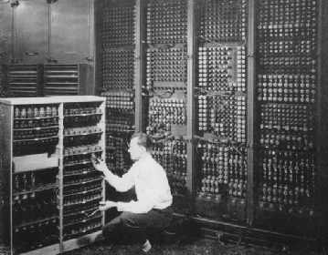
ENIAC - 1946
Three Preceding Technologies that led to the ENIAC
Like all great inventions, the ENIAC built on existing concepts. Here are three that played a large role in the development of the ENIAC:
Mechanical Brains
Abacus
Slide Rule
Difference Engine
Mechanical Calculators
Differential Analyzer
The Vacuum Tube
Faster Switches mean Faster Computers
Electromagnetic Relays
Tube is like a "valve"
The Punched Card
Jacquard Loom
The US Census of 1890
Tabulating Machines grow in popularity
These three ideas found a home in the mind of Professor John Mauchly, who conceived of the ENIAC.

Slide 26
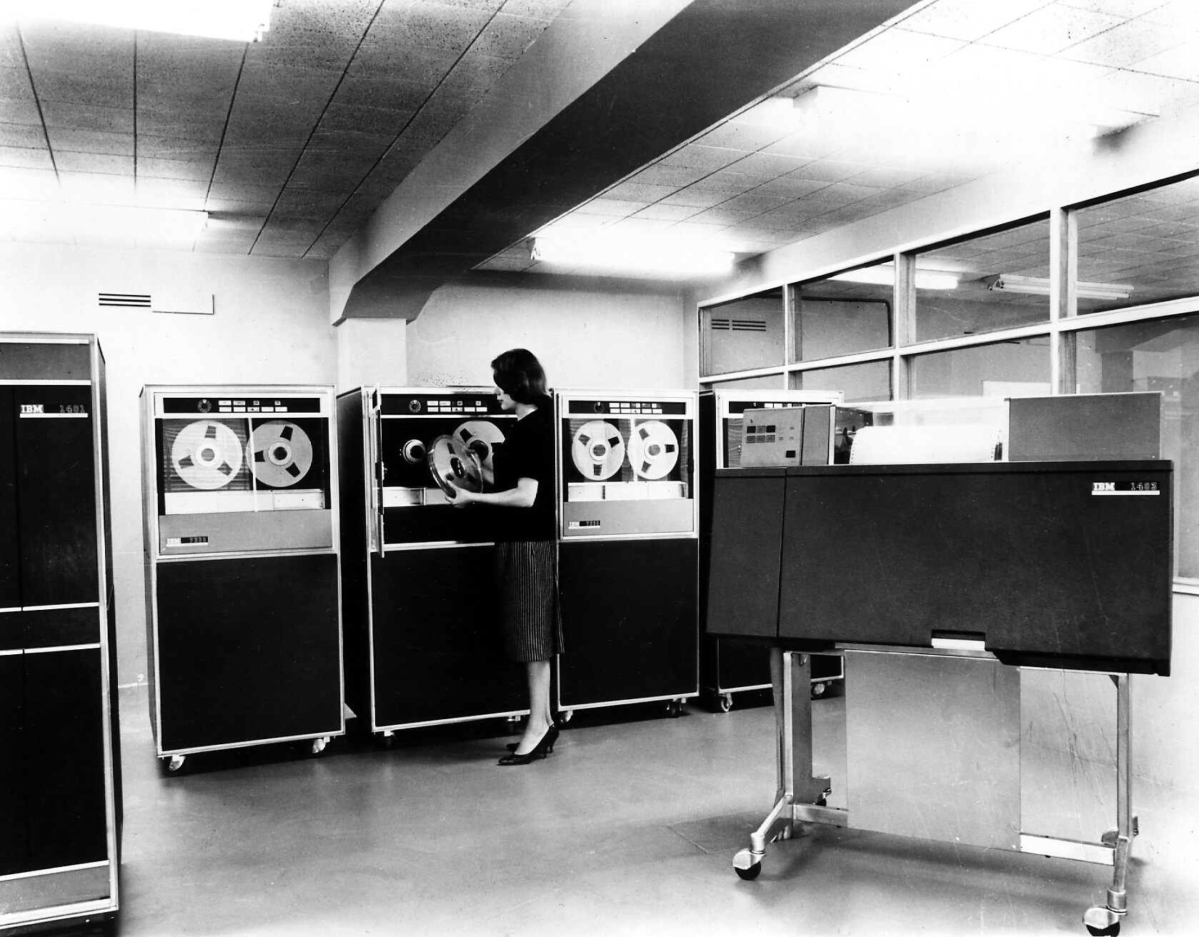
IBM 1401
The IBM 1401 Data Processing System, a stored-program transistor-logic computer announced October 1959. At $2500 per month minimally configured, this was IBM's first affordable general-purpose computer.
The 1401 was a decimal (not binary) computer, with variable-length words composed of 8-bit bytes containing 6-bit BCD (binary coded decimal) characters (plus parity and wordmark bits), and was intended primarily for business applications (its scientific counterpart was the 1620).
Originally programmed only in machine or assembly language or (a bit later) Autocoder, which proved difficult for many people, the 1401 was soon host to one of the earliest high-level business-oriented programming languages, RPG (Report Program Generator), which increased its usability and popularity [4]. Later FORTRAN was added for scientific programming.
Notes:
The IBM 1401 Data Processing System, a stored-program transistor-logic computer announced October 1959. At $2500 per month minimally configured, this was IBM's first affordable general-purpose computer, and it was intended to take the place of all the accounting machines and calculators that still provided a cheaper alternative to IBM's 650 and 70x computers. Thousands of 1401s were sold or rented; in fact, it was the first computer to deploy 10000 units. The 1401 was a decimal (not binary) computer, with variable-length words composed of 8-bit bytes containing 6-bit BCD (binary coded decimal) characters (plus parity and wordmark bits), and was intended primarily for business applications (its scientific counterpart was the 1620). The 1401 was the first in IBM's 1400 series of computers, which later included the 1410, 1440, and 1460. Originally programmed only in machine or assembly language or (a bit later) Autocoder, which proved difficult for many people, the 1401 was soon host to one of the earliest high-level business-oriented programming languages, RPG (Report Program Generator), which increased its usability and popularity [4]. Later FORTRAN was added for scientific programming.
According to Hugh T. Hoskins, there was an assembler called SOPAT, delivered from IBM, prior to the appearance of Autocoder. This was at the University of Southern California School of Business in 1962. Also see the later comments from Keith Williams below. The 1401 was so popular that (according to legend) 1401 applications were still running in 2000 on 1401 simulators (which themselves might be 70x0 applications, therefore running on simulators of their own), and this presented a special challenge in the Year-2000 conversion. You can bet that 1960-era programmers with a only few thousand bytes of memory at their disposal didn't "waste core" on 4-digit years!.
Pictured (left to right; follow links for bigger pictures):
Model 1402 Card reader / punch
7330 Magnetic Tape Unit
1407 Console Inquiry Station
The 1401 computer itself with its control panel upper left
a 1405 Disk Storage Unit
1403 printer.
The 1403 printer could print up to 1400 132-column lines per minute, sometimes more. The 1402 reader/punch could accommodate 1000 cards (half a box) in its hopper, read 800 cards per minute, and punch 250 cards per minute. Loren Wilton (of Burroughs/Unisys, who worked with the 1401 while in college) pointed out (31 Dec 2003) that:
... if you let a handful of cards fall down into the read feed (which was normally done when loading the tray, and would happen as soon as you started the reader anyway) the tray plus the read feeder would hold an entire box of cards easily, or 2000+ cards. This was quite handy, since it reduced the amount of time you had to spend loading the cards into the reader, and you could devote your time to managing the punch, which had a much smaller hopper, and the read/punch stackers, which only held around 800 to 1000 cards at most in each stacker. Typically only the right stacker was used for the reader, and the left stacker used for the punch, so multiple stackers didn't help much.
If you were running a job that printed data onto preprinted forms, (especially with multipart paper or stiff paper) you would also have to devote a fair amount of time to monitoring the 1403 stacker to make sure that you didn't end up with forms spilling all over the floor rather than stacking neatly in the stacker. Thick forms tended to not stack well, especially if the printer were doing a lot of high-speed slews, as was typical in forms jobs.
Not shown: the 1406 storage unit containing core memory. The 1401 was equipped with up to 4K 8-bit characters of core memory; the 1406 increased its memory capacity to 8K, 12K, or 16K (thus the 1401 shown above has 4K).
The 1405 Disk Storage Unit Model 1 had a capacity of "10 million alphanumerical characters stored on 25 disks" (platters). The Model 2 held 20 million characters on 50 platters. Each platter is accessed by its own access arm (read/write head). This is one of the earliest production disk drives, the direct descendent of the original IBM 305 Disk File introduced with its RAMAC (RAndoM ACcess) computer in 1956. "The in-line method of data processing continually maintains the records of a business in up-to-date status. Any transaction affecting a business can be processed when it occurs, and all the records and accounts affected are updated immediately. The executives of an organization have available, at any time, information representing the status of any account at that moment."
[http://images.google.com.br/imgres?imgurl=http://www.columbia.edu/acis/history/1401/printer.jpg&imgrefurl=http://www.columbia.edu/acis/history/1401.html&h=969&w=800&sz=276&hl=pt-BR&start=2&tbnid=UlpK2npqzNCtOM:&tbnh=148&tbnw=122&prev=/images%3Fq%3DIBM%2B1401%26svnum%3D10%26hl%3Dpt-BR%26lr%3D]

Slide 27
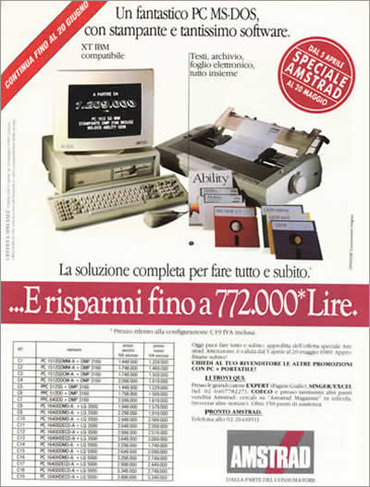
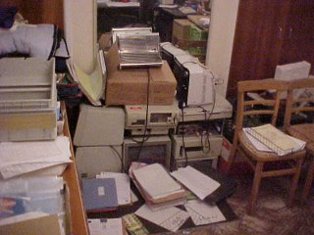
IBM PC XT

Slide 28
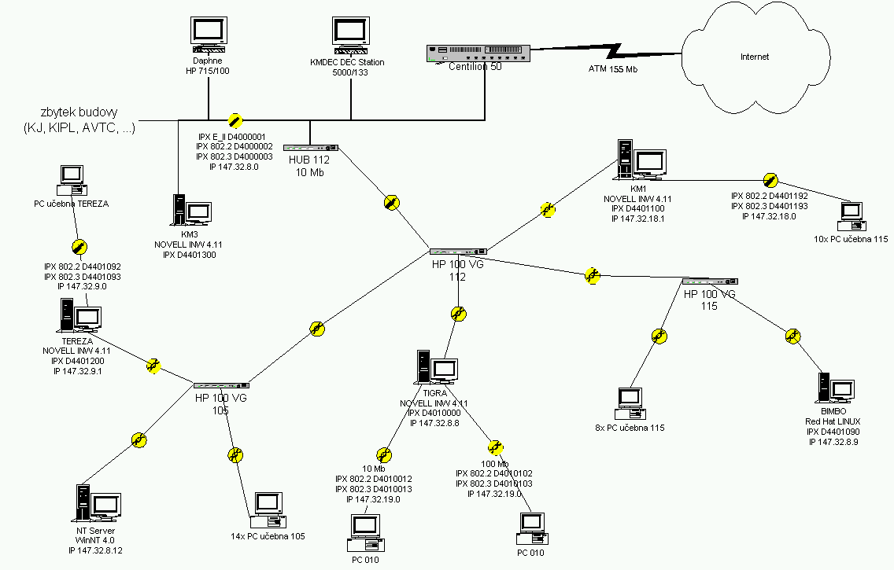
Redes: LAN, WAN, RAM…

Slide 29
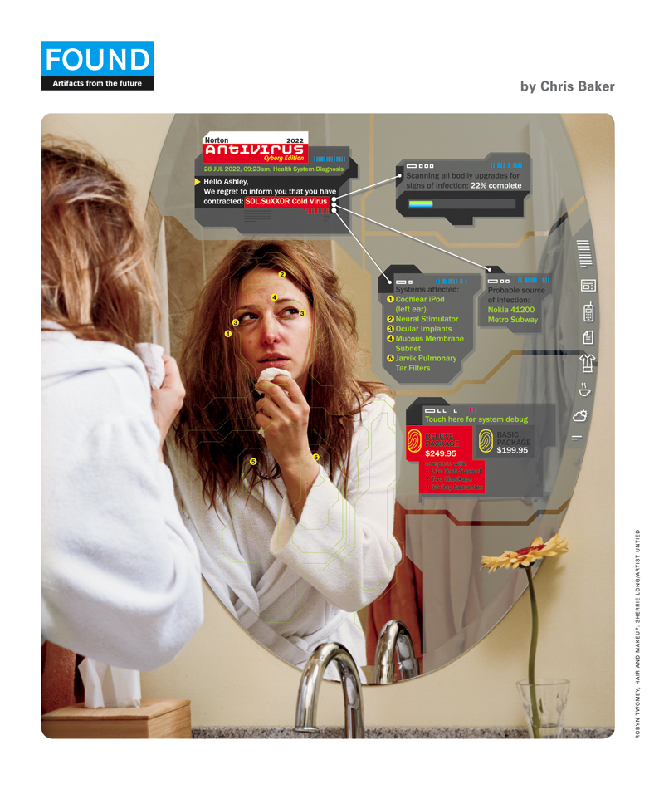
Co-Processadores no Corpo

Slide 30



Seres Humanos como Co-Processadores
Notes:
Google Image Labeler: Bionic Software Strikes Again
By tim on September 02, 2006
The launch of Google Image Labeler, a "game" that asks people to label images, and figures that images given the same label by multiple people are likely to be correct, continues the Web 2.0 trend towards bionic software, that is, software that combines machine and human intelligence. This is really just another version of the web 2.0 principle, harnessing collective intelligence, but with an emphasis on "harnessing" rather than on "collective."
Like Distributed Proofreaders (the granddaddy in the space), Amazon's Mechanical Turk, and mycroft, but unlike, say, a Flickr tag cloud as a reflection of collective labeling of images, Google Image Labeler puts people explicitly to work.
There's a spectrum of ways to put humans to work refining computer results, from the implicit to the explicit. The most explicit, of course, is going to be when the third world job shops now engaged in making booty for World of Warcraft start offering their services for more general hire.
Bionic Software
By tim on March 06, 2006
Boxxet founder You Mon Tsang recently introduced a new meme into my vocabulary: "bionic software." As You Mon defines it, "Bionics is the study of living systems with the intention of applying their principles to the design of engineering systems." But when we spoke a month or so ago, he used a folksier definition, referencing the seventies TV show The Six Million Dollar Man, which featured Lee Majors as an injured astronaut rebuilt with technology that made him faster, stronger, and more capable. Using this image, a bionic system is one that combines the biological and mechanical systems to create an enhanced system that is more powerful than either alone.
It strikes me that this "bionic" aspect is critical to many of the most successful web applications. Back in 2003, I began using an illustration of von Kempelen's Mechanical Turk in my talks, to emphasize the point that one of the things that distinguishes web applications from PC-era applications is the fact that web applications actually have people inside them, working daily as part of the application. Without the programmers running the crawl at Google, filtering out the spam, and tuning the algorithms, the application stops working. Without the users feeding the spiders by continuously linking to new sites, the crawl turns up nothing new. In a profound way, the users are part of the application. This turns out to be true in one form or another for almost every breakthrough web application.
I generalized this idea into one of the key principles of Web 2.0, namely the architecture of participation, the idea that one of the most important principles in internet application design is to architect systems in such a way that they become more powerful the more they are used. But the term "bionic systems" gives a new twist on this concept.
What I realized after talking to You Mon is that systems that combine human and computer activity to produce better results than either can alone are becoming both more widespread and more explicit. Take for example flickr, which introduced the tag cloud to the web design palette. The tag cloud is a powerful user-interface element that is created dynamically by user activity. Or consider how digg.com explicitly harnesses its users to drive which stories go to the front page. (And yes, I'm aware that slashdot did this long before digg, but with digg, this feature is the heart of the site.)
It seems to me that what we're seeing now is just the beginning of a really significant trend, as bionic systems become more widespread and variations on the technique more sophisticated. You Mon's new startup, Boxxet, effectively lets people create a digg-like site for any topic they want to aggregate attention around, with users moderating up content that is initially acquired by a web spider. (The site is still in private beta, but should be open in a few weeks. You Mon is also presenting it at ETech this Wednesday.) Whereas a Google Alert, say, lets you harness the power of Google to track any topic that you want to follow, Boxxet lets you create a public, shared space in which to follow a topic you care about, and uses the opinions of your fellow readers to improve the automated results.
Amazon's Mechanical Turk application makes an even more explicit tie between human and machine: it is a marketplace for tasks that combine human and computer processing. (I haven't yet confirmed the fact, but I wonder if my May 2003 talk at an Amazon all-hands meeting, which featured my concept of the Mechanical Turk as a metaphor for web applications, inspired their service.)
I was talking about the idea of bionic software with Tom Shields of the Woodside Fund a few weeks ago, and explaining how I thought that the old dreams of artificial intelligence were being replaced by this new model, in which we are creating more intelligent systems by using humans as components of the application. Tom neatly summed up the paradigm shift: "AI becomes IA." ("Artificial Intelligence becomes Intelligence Augmentation.")
This is the power of memes: they are framing concepts that help you to see the world in a new way. Now that I understand that we're building a next generation of bionic systems, I'm seeing them everywhere. I'd love your thoughts. Where else are you seeing this fusion of human and computer to build capabilities beyond the reach of either alone?
P.S. For the science fiction lovers among you, there's a great take on this concept in Sean McMullen's book, Souls in the Great Machine.

Slide 31
Fim dos Slides

